Slide 1
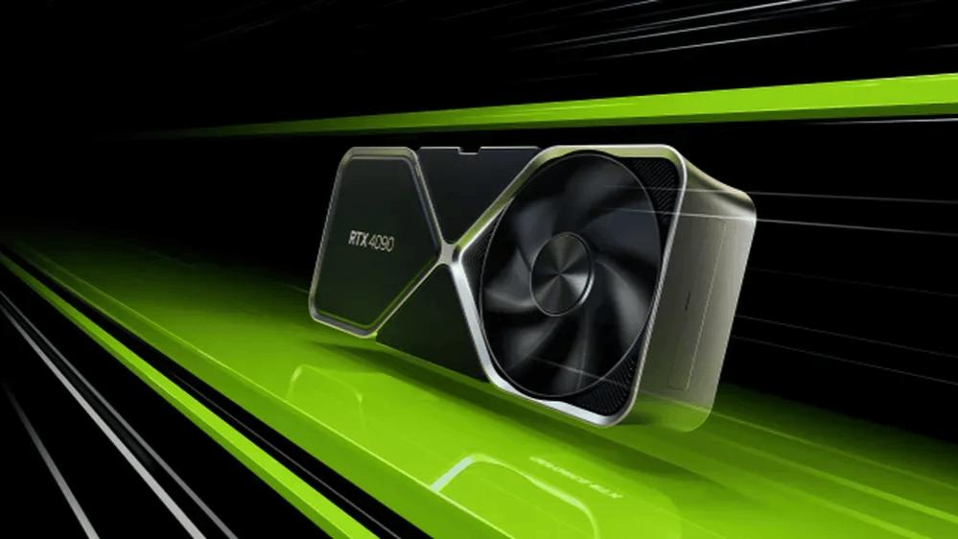
Power of GPUs
Bikram Kumar
23UCS012
Sem: 5th A
Graphics Processing Unit

Slide 2

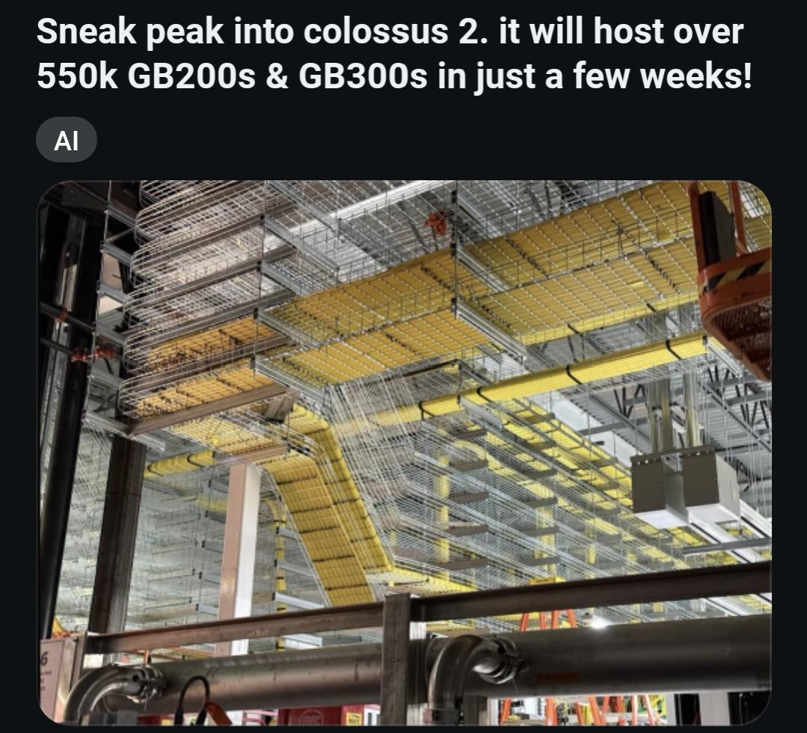
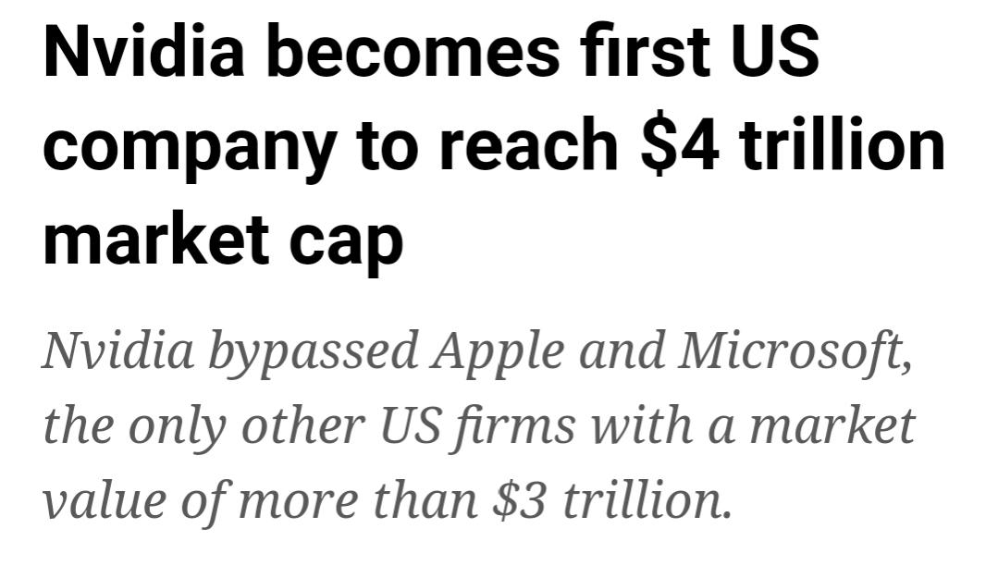



Why GPUs?

Slide 3
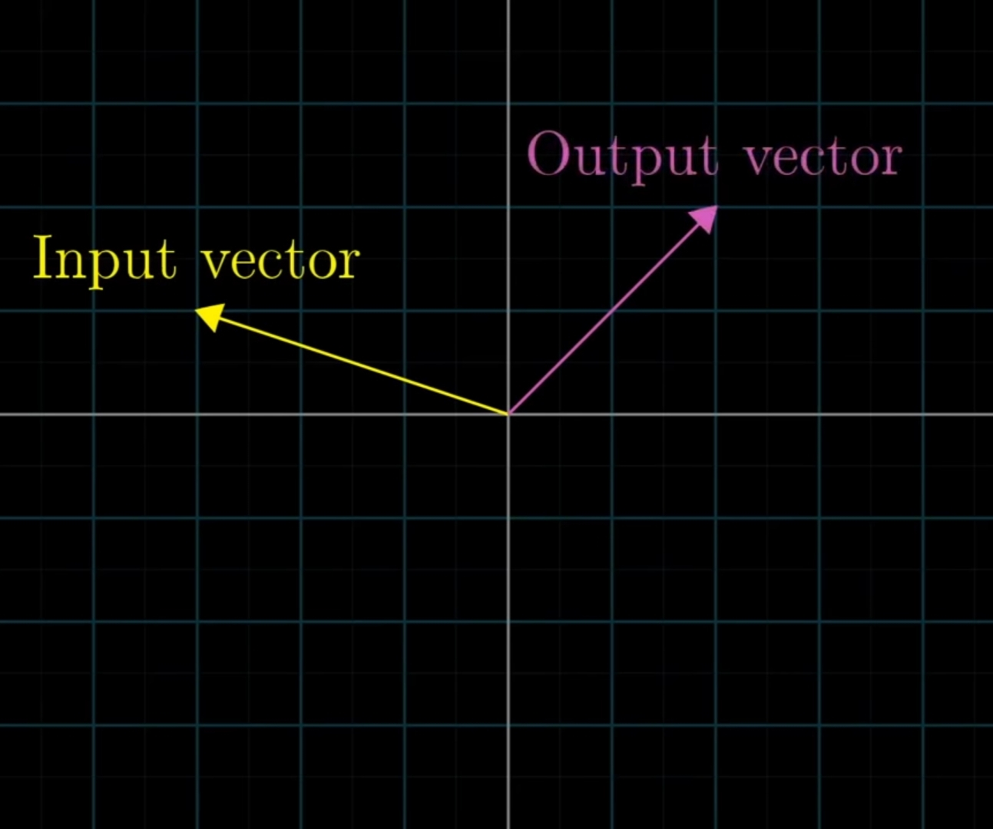
Linear Algebra
• A Transformation maps a vector from one space to another.
• Every Linear Transformation can be achieved by some matrix multiplication.
• Scaling, rotations, reflections, and projections are some Linear Transformations.

Slide 4
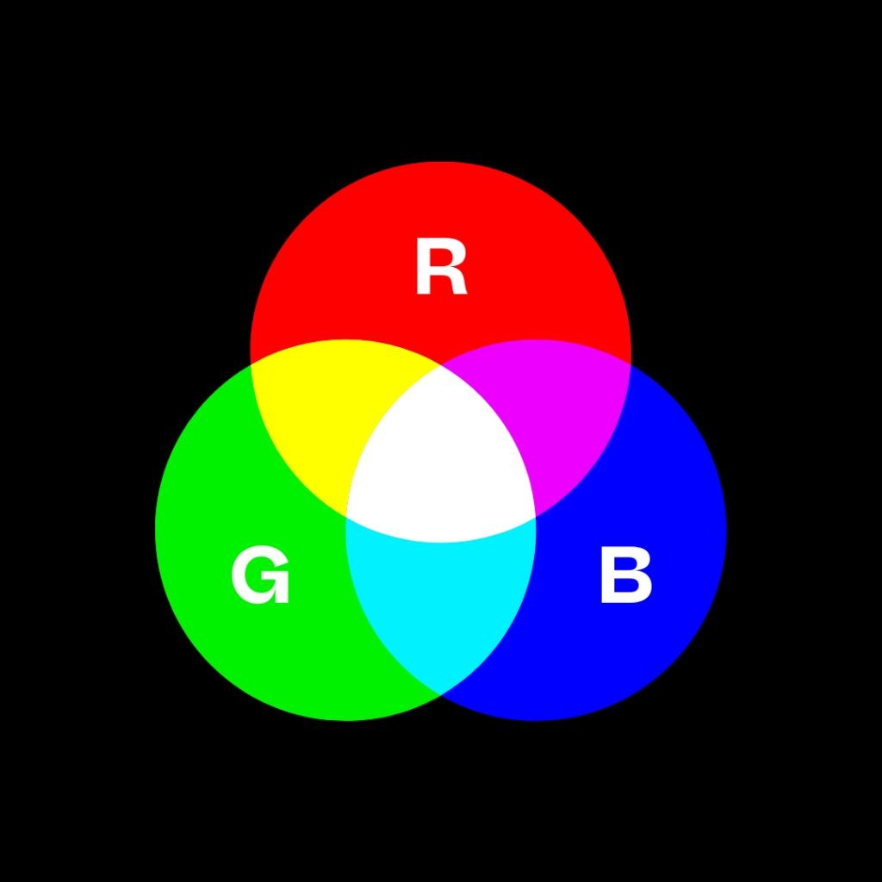
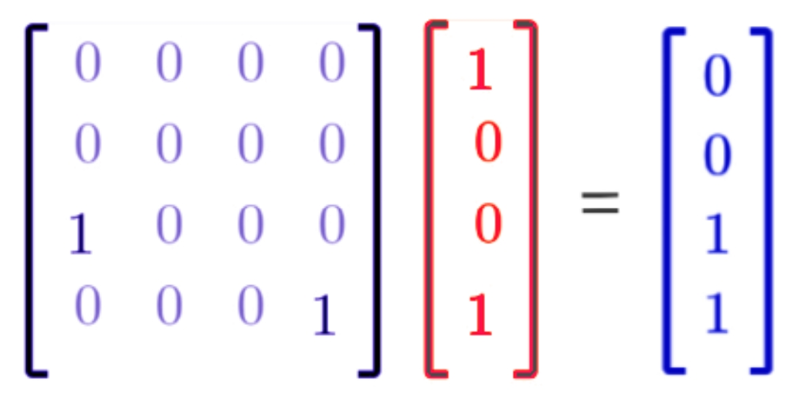
Colors: RGBA
• Every color is created with Red, Green and Blue lights.
• With transparency, RGBA can be treated as 4D vector.
Matrix to transform Red into Blue

Slide 5
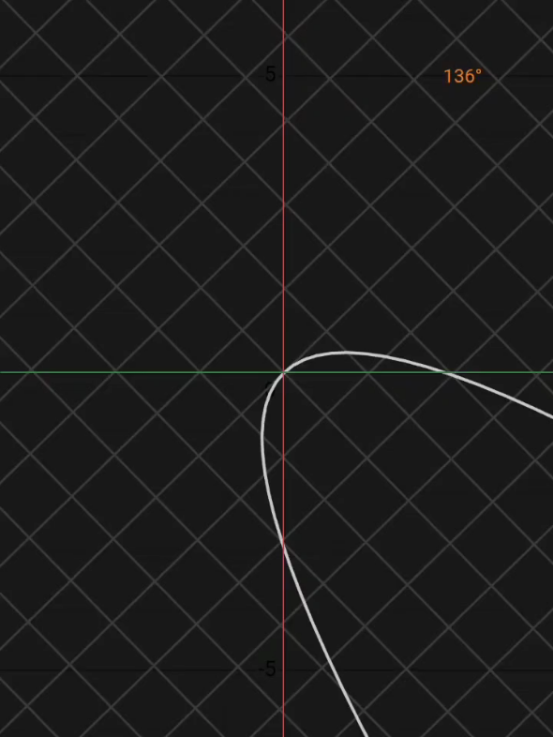
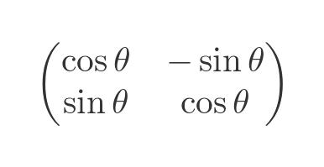
Rotation Matrix
This matrix rotates the space!

Slide 6

Calculations needed to render 1 frame live:
= 2 million pixels *
1000 operations per px
= 2 billion operations
1920 x 1080 pixels screen
A CPU with 2.4 GHz clock speed would do that in about 1 second

Slide 7
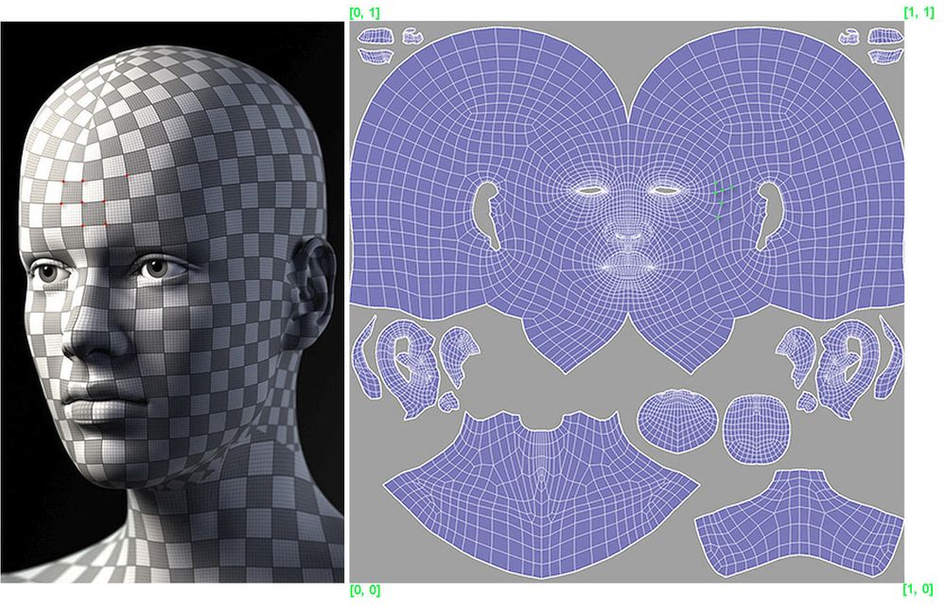
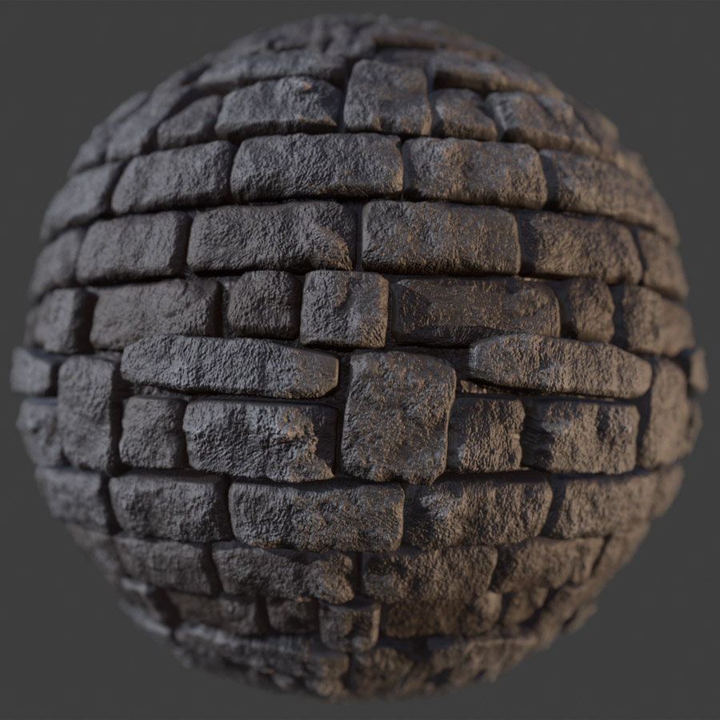
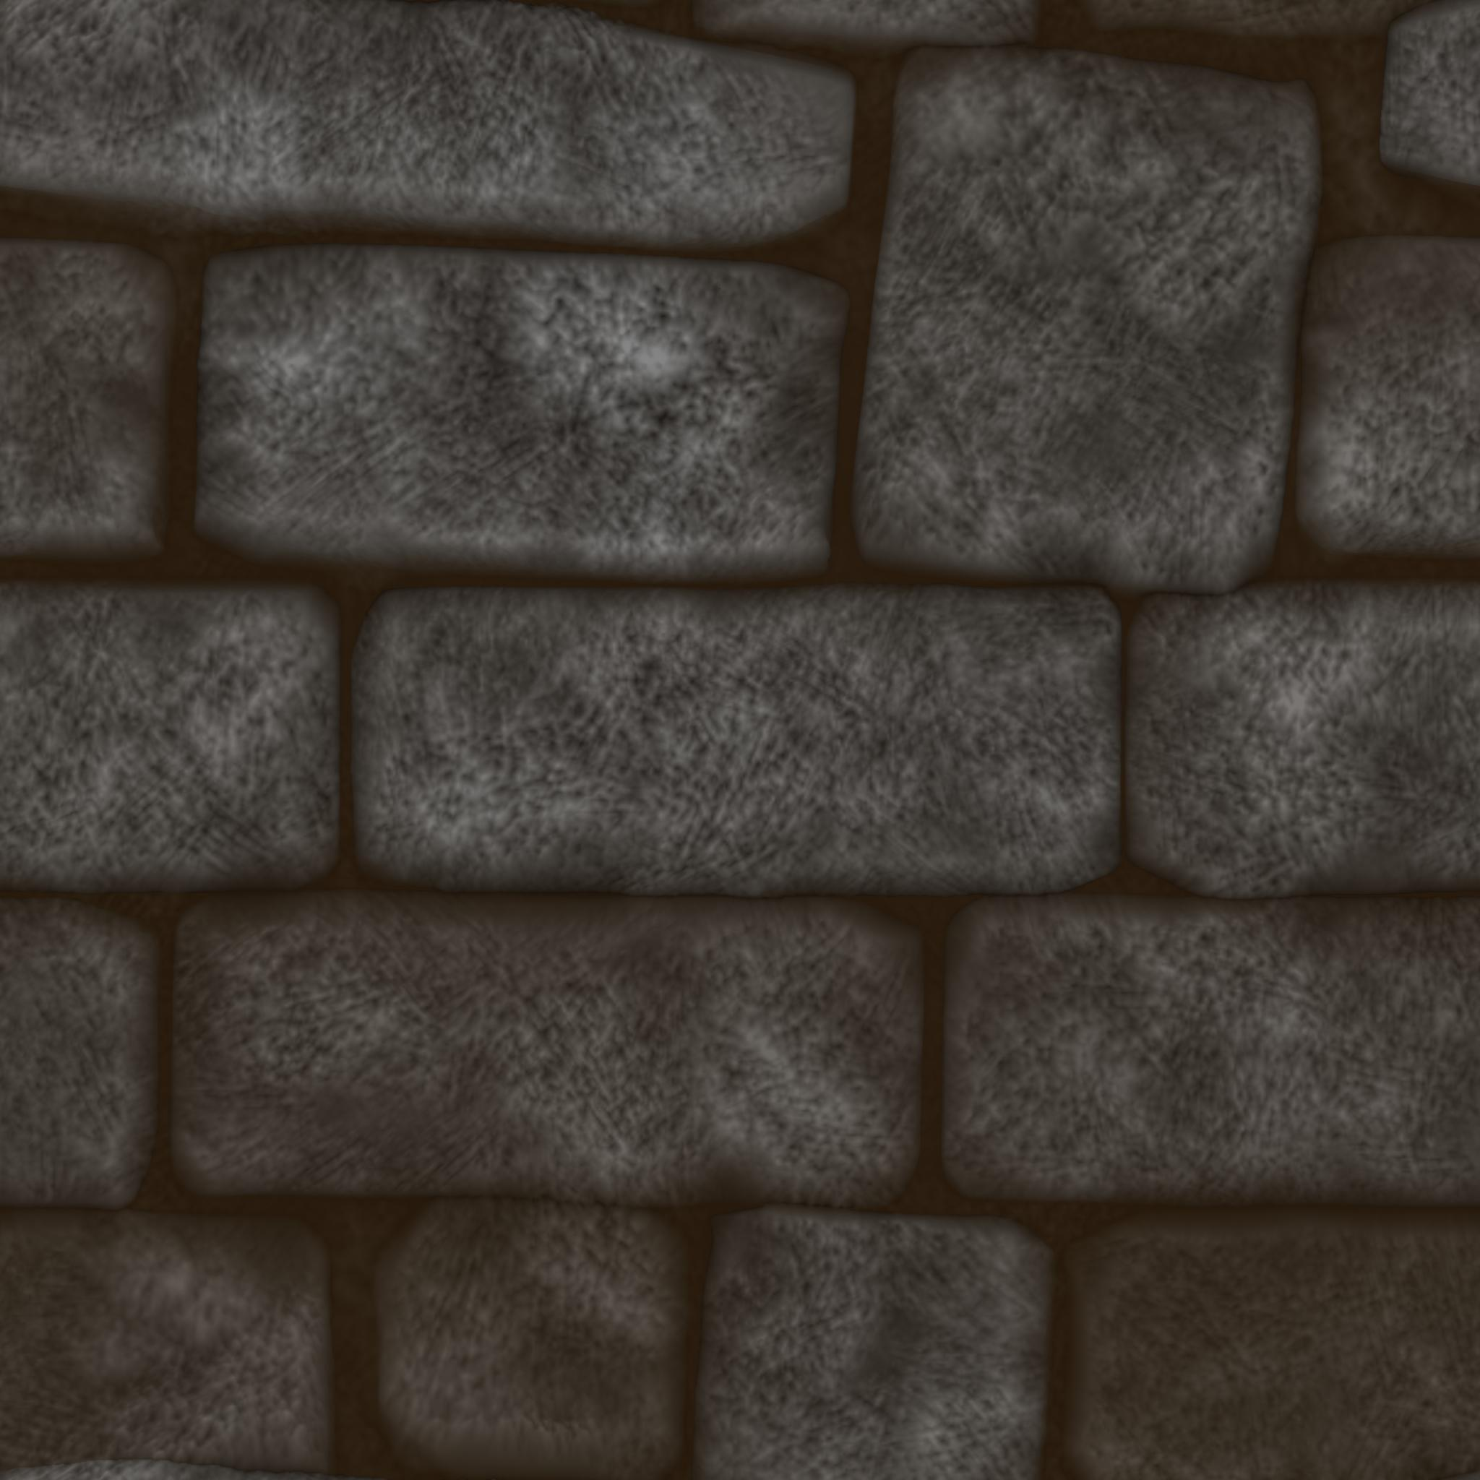
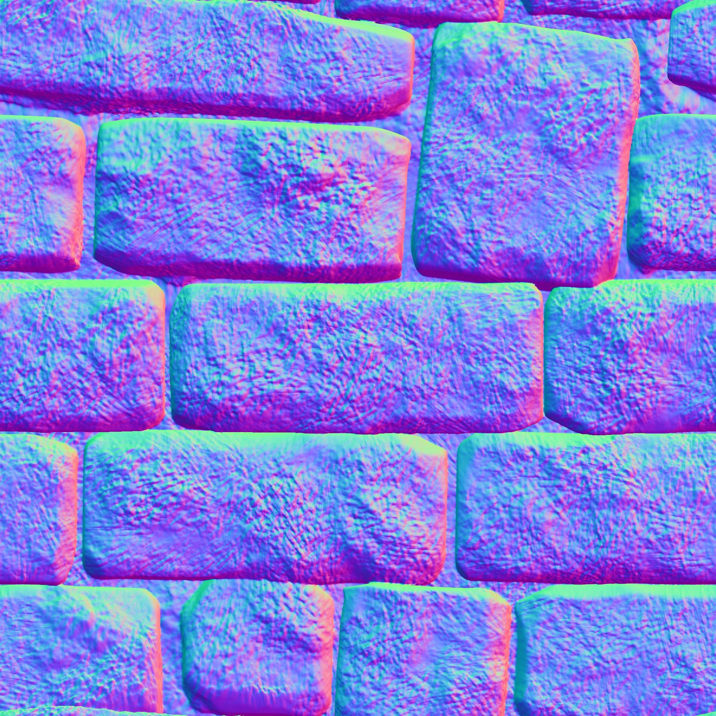
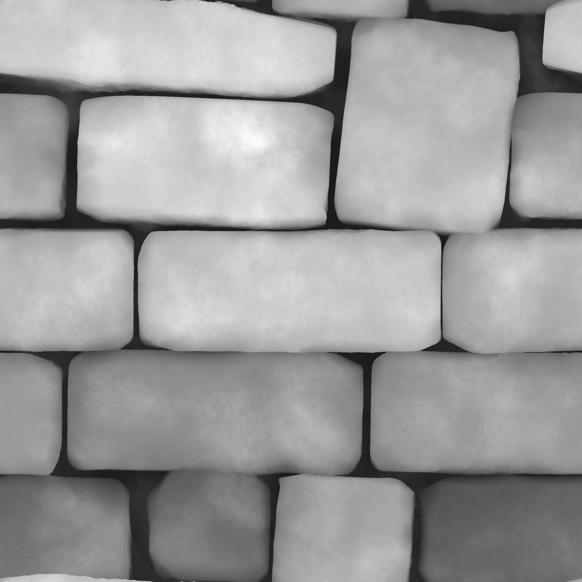
How is 3D done?
• Everything is created with triangles.
• 3D XYZ to 2D UV mapping.
• Procedural as well as preprocessed textures used.

Slide 8
Animating at 60 FPS
1/60 seconds (16 ms) available to render 1 frame
Physics
Textures fetching
Lighting calculations
Interactivity
We need something faster!

Slide 9
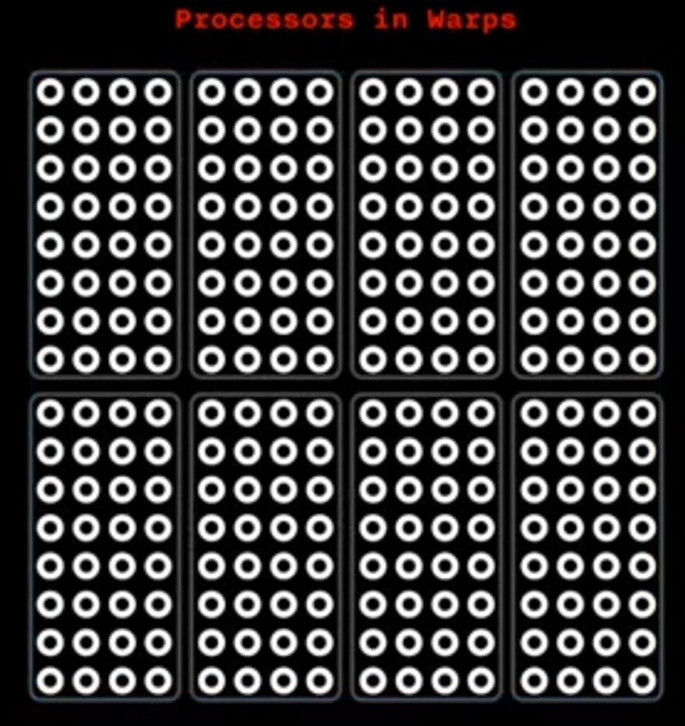
Thousands of cores
RTX = Raytracing Texel eXtreme
• GPU is so fast it takes more time to pass data to it than it takes to process that.
RTX 4090 has 16384 cores!

Slide 10
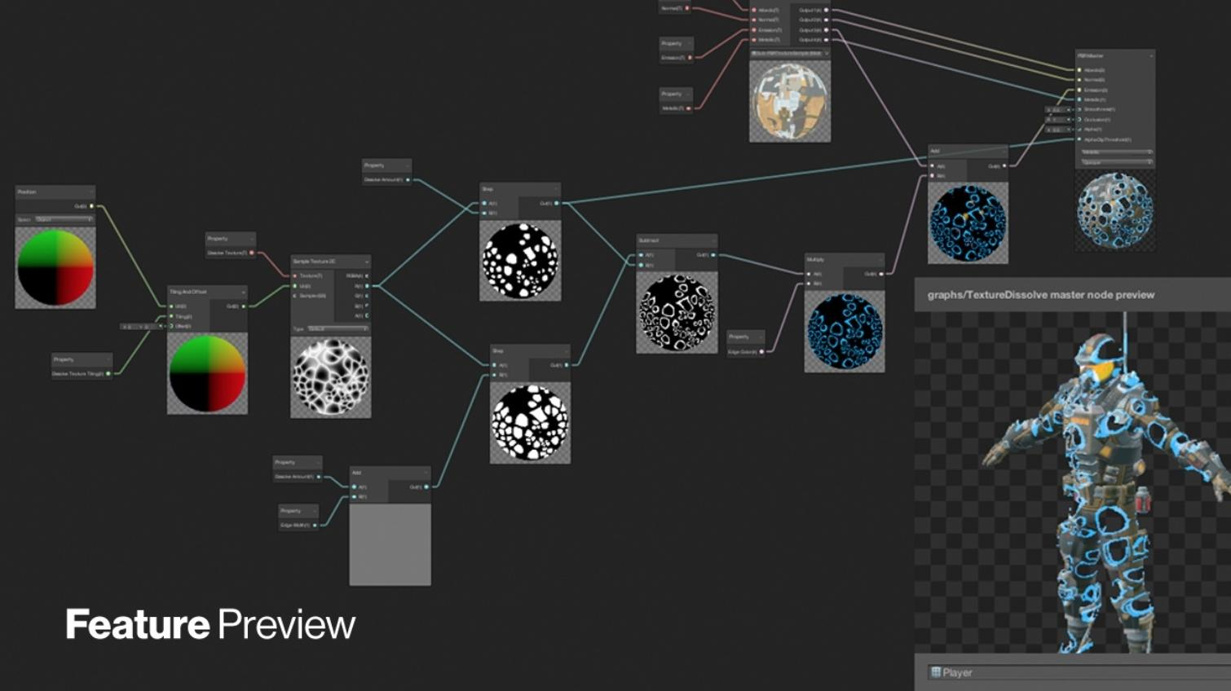
Shaders
• GPUs are programmed in a shading language like GLSL or HLSL.
• But mostly they are created with Shader Graphs

Slide 11
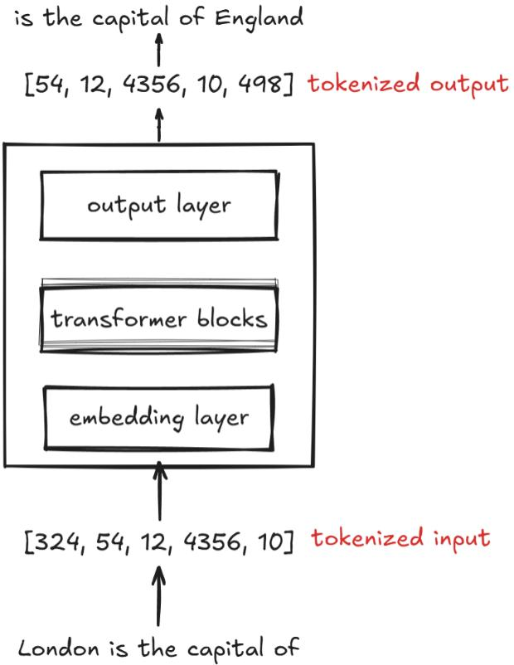
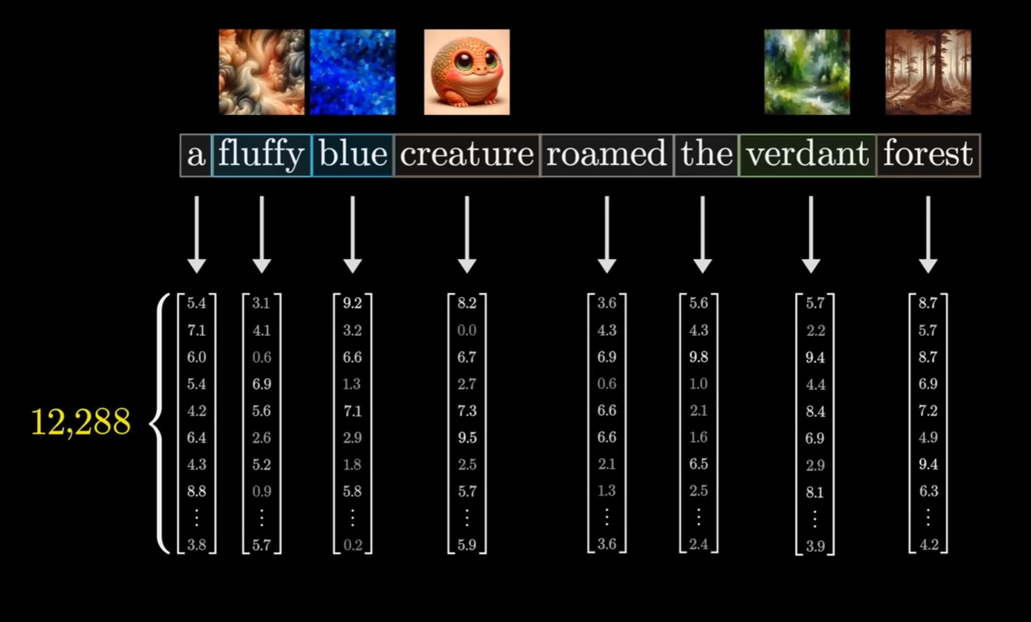
Where Vectors in AI?
Text and media is changed into embeddings

Slide 12
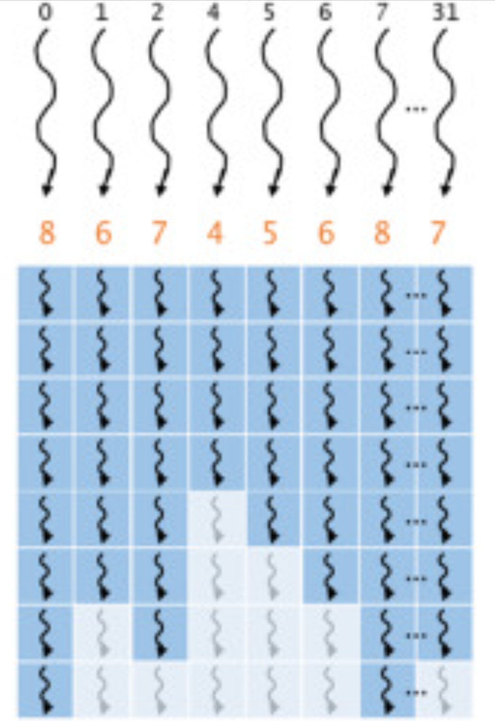
Branching
• GPUs excel at parallel tasks but destroy when threads scatter.
• Never use an if-statement in a shader!

Slide 13




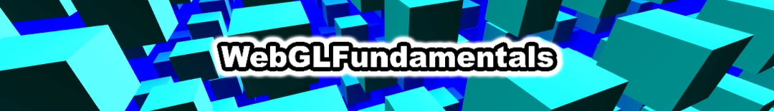

A little task for you
Think about how can we implement if-else without branching.
If you liked GPUs, dive in!

Slide 14
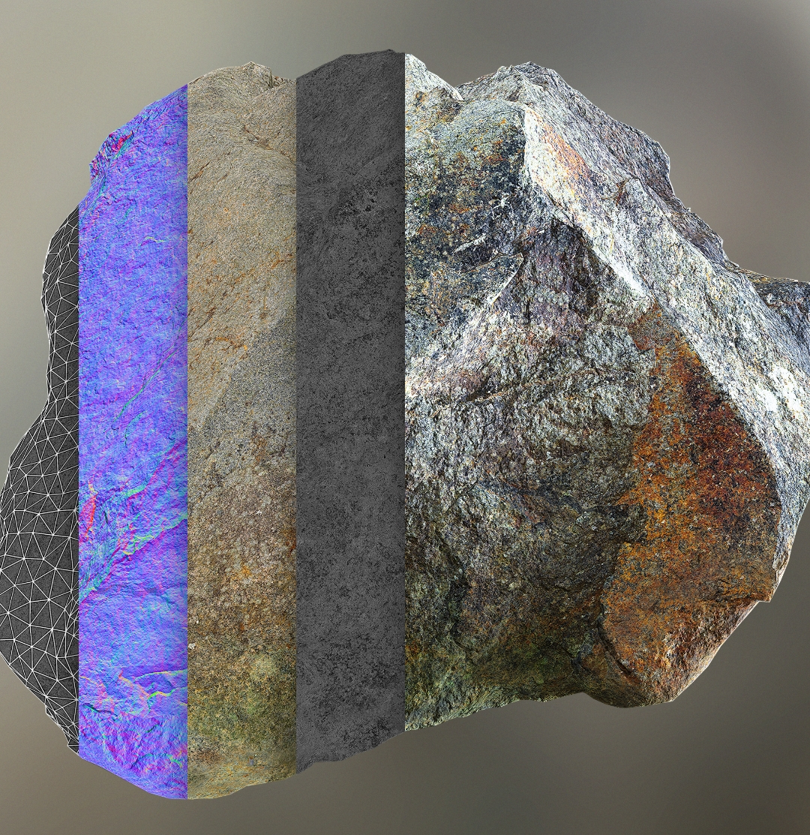
Thank You

